Slide 1
Employee Data Analysis using Excel
STUDENT NAME: HEMANTH KUMAR AP
REGISTER NO: 312212584(NM ID: asunm1441312212584)
DEPARTMENT: B.COM (COMPUTER APPLICATION)
COLLEGE: SREE MUTHUKUMARASWAMY

Slide 2
PROJECT TITLE
Employee Performance Analysis using Excel

Slide 3


AGENDA
Problem Statement
Project Overview
End Users
Our Solution and Proposition
Dataset Description
Modelling Approach
Results and Discussion
Conclusion
3/21/2024 Annual Review

Slide 4

PROBLEM STATEMENT
"Employee performance is crucial for organizational success, but inconsistent and subjective evaluations can lead to inefficiencies. This project aims to develop an Excel-based system for tracking and analyzing key performance indicators (KPIs) such as productivity, attendance, and task completion. The goal is to provide clear insights for more consistent and data-driven employee performance reviews."

Slide 5

PROJECT OVERVIEW
"This project focuses on creating an Excel-based tool to analyze employee performance data. The system will track key performance indicators (KPIs) like productivity, attendance, and task completion, enabling managers to make data-driven decisions. By automating calculations and visualizing data through charts and graphs, the tool will streamline performance reviews and help identify areas for improvement, ultimately enhancing overall organizational efficiency."
.

Slide 6

WHO ARE THE END USERS?
HR Managers: They will use the tool to assess employee performance, manage talent, and make informed decisions regarding promotions, training, and employee development.
Team Leaders/Supervisors: They can use the system to track the performance of their team members, identify areas for improvement, and recognize top performers.
Senior Management/Executives: They may review the overall performance data to guide strategic decisions related to workforce management, departmental productivity, and operational efficiency.
Employees : In some cases, employees might be given access to their performance data to better understand their strengths and areas for development.

Slide 7

OUR SOLUTION AND ITS VALUE PROPOSITION
Our Solution: "We offer an Excel-based Employee Performance Analysis tool that automates the tracking and evaluation of key performance indicators (KPIs) such as productivity, attendance, and task completion rates. It generates automated reports and visual insights through charts, making it easier to evaluate individual and team performance."
Value Proposition: "Our solution streamlines the performance evaluation process, saving time and effort for managers while increasing the fairness and consistency of employee assessments.Ultimately, this leads to improved employee productivity, enhanced team dynamics, and greater overall organizational efficiency."

Slide 8
Dataset Description
Employee ID: Unique identifier for each employee.
Department: The department or team the employee belongs to.
Position/Role: Job title or role of the employee.
Work Hours Logged: The number of hours worked by the employee over a specific period.
Task Completion Rate: Percentage of tasks completed within assigned deadlines.
Attendance Record: Number of days present, absent, or late.
Performance Ratings: Evaluation scores provided by supervisors on various criteria, such as quality of work and efficiency.
Training Hours: Number of hours spent in training or professional development.

Slide 9

THE "WOW" IN OUR SOLUTION
The "Wow" in Our Solution: "Our solution goes beyond basic performance tracking—it's a powerful, fully automated Excel tool that transforms raw employee data into actionable insights with just a few clicks. What sets it apart is its ability to generate real-time visual dashboards and performance reports without the need for complex software. It delivers the sophistication of advanced analytics in a familiar and accessible format, ensuring that managers of any skill level can make data-driven decisions effortlessly. This combination of simplicity, automation, and depth of analysis is what truly makes our solution stand out."
3/21/2024 Annual Review
9

Slide 10
MODELLING
Data Preparation:Data Cleaning: Remove duplicates, handle missing values, and ensure consistency in data formats.
Normalization: Standardize data ranges for better comparison and analysis.
Performance Metrics Calculation:Productivity Scores: Calculate based on task completion rates and work hours logged.
Attendance Metrics: Analyze attendance records to assess punctuality and absenteeism.
Quality Ratings: Aggregate performance ratings from supervisors to gauge work quality.
Trend Analysis: Identify patterns and trends in employee performance over time.
Comparative Analysis: Compare performance metrics across different departments or roles.
10

Slide 11
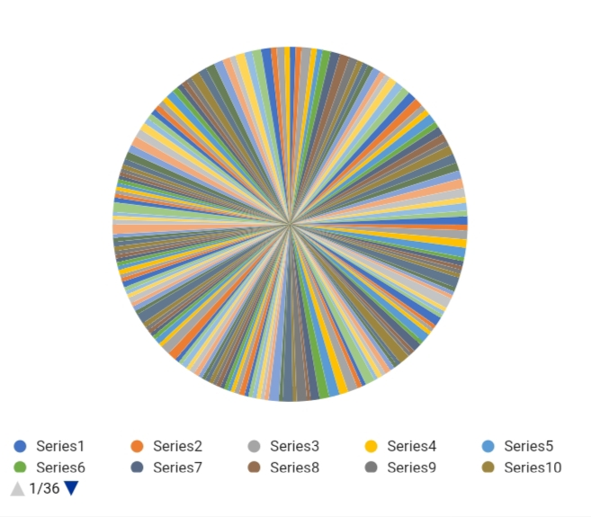
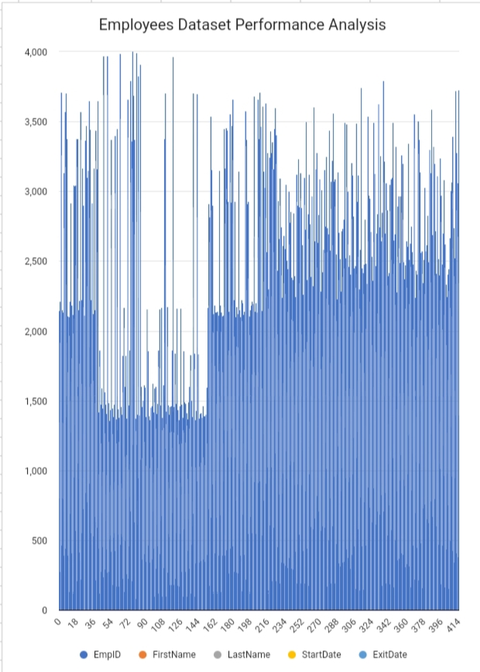
RESULTS
11

Slide 12
conclusion
"The Employee Performance Analysis tool developed using Excel has successfully addressed the challenges of performance evaluation by providing a streamlined, data-driven approach. The tool enhances visibility into employee performance through automated calculations and dynamic visualizations, enabling more informed and consistent decision-making. By improving the efficiency of performance reviews and identifying key trends and patterns, the solution supports better management practices and promotes a fair and transparent work environment. Overall, this tool contributes to increased organizational effectiveness and employee engagement, showcasing the value of leveraging data for strategic HR decisions."

